Slide 1
8 Steps to Becoming Awesome with Kubernetes
@burrsutter
burr@redhat.com
JavaDay UA Recording
http://bit.ly/8stepsawesome
Link

Slide 2




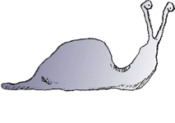

Your Journey to Awesomeness
Re-Org to
DevOps
Self-Service,
On-Demand,
Elastic Infrastructure
Automation
Puppet, Chef, Ansible,
Kubernetes
CI & CD
Deployment Pipeline
Advanced
Deployment
Techniques
Microservices
@burrsutter

Slide 3







DevOps Cast of Characters
OPS
PMO
BIZ
SEC
DEV
QA
DBA
@burrsutter

Slide 4







More DevOps Cast of Characters
DEV
OPS
PMO
BIZ
DBA
QA
SEC
@burrsutter

Slide 5
8 Steps
0 - Introduction
1 - Installation & Getting Started
2 - Building Images, Running Containers
3 - oc/kubectl exec magic
4 - Logs
5 - Service discovery & load-balancing
6 - Live & Ready
7 - Rolling updates, Canaries, Blue/Green
8 - Debugging
Bonus
@burrsutter

Slide 6
Step 0: Introduction
@burrsutter bit.ly/8stepsawesome

Slide 7
A Challenge
Have you ever had “/” vs “\” break your app? Or perhaps needed a unique version of a JDBC driver? Or had a datasource with a slightly misspelled JNDI name? Or received a patch for the JVM or app server that broke your code?
.war or .ear
Custom Configuration
JDBC driver, datasource, JMS queue, users
Containerize
Your
App
Application Server
Weblogic 10.x.y, Tomcat 6.x.y, JBoss EAP 6.x.y
Java Virtual Machine
Java 1.6.6_45 or Java 1.7.0_67
Operating System
Linux Kernel Version & Distribution
Server Hardware
@burrsutter bit.ly/8stepsawesome

Slide 8
Email
MyApp.war has been tested with the following
On my Windows 7 desktop
JDK 1.8.43
Wildfly 9
Configuration:
Datasource: MySQLDS
Tested with: mysql-connector-java-5.1.31-bin.jar
Production Environment
Red Hat Enterprise Linux 6.2
JRE 1.7.3
WebSphere 8.5.5
Oracle 9
@burrsutter bit.ly/8stepsawesome

Slide 9
Dockerfile
Container Guest OS
FROM centos/wildfly
COPY standalone.xml /opt/wildfly/standalone/configuration/
COPY mysql-connector-java-5.1.31-bin.jar /opt/wildfly/standalone/deployments/ COPY mysql-sample-ds.xml /opt/wildfly/standalone/deployments/
COPY myapp/target/your.war /opt/wildfly/standalone/deployments/
Java App Server
custom configuration
dependencies
your.war
@burrsutter
Note: There are better ways to handle Java apps, this is for illustration purposes

Slide 10
Docker Tutorial
bit.ly/docker-devnexus2017
@burrsutter bit.ly/8stepsawesome
developers.redhat.com
Notes:
Docker Demo

Slide 11






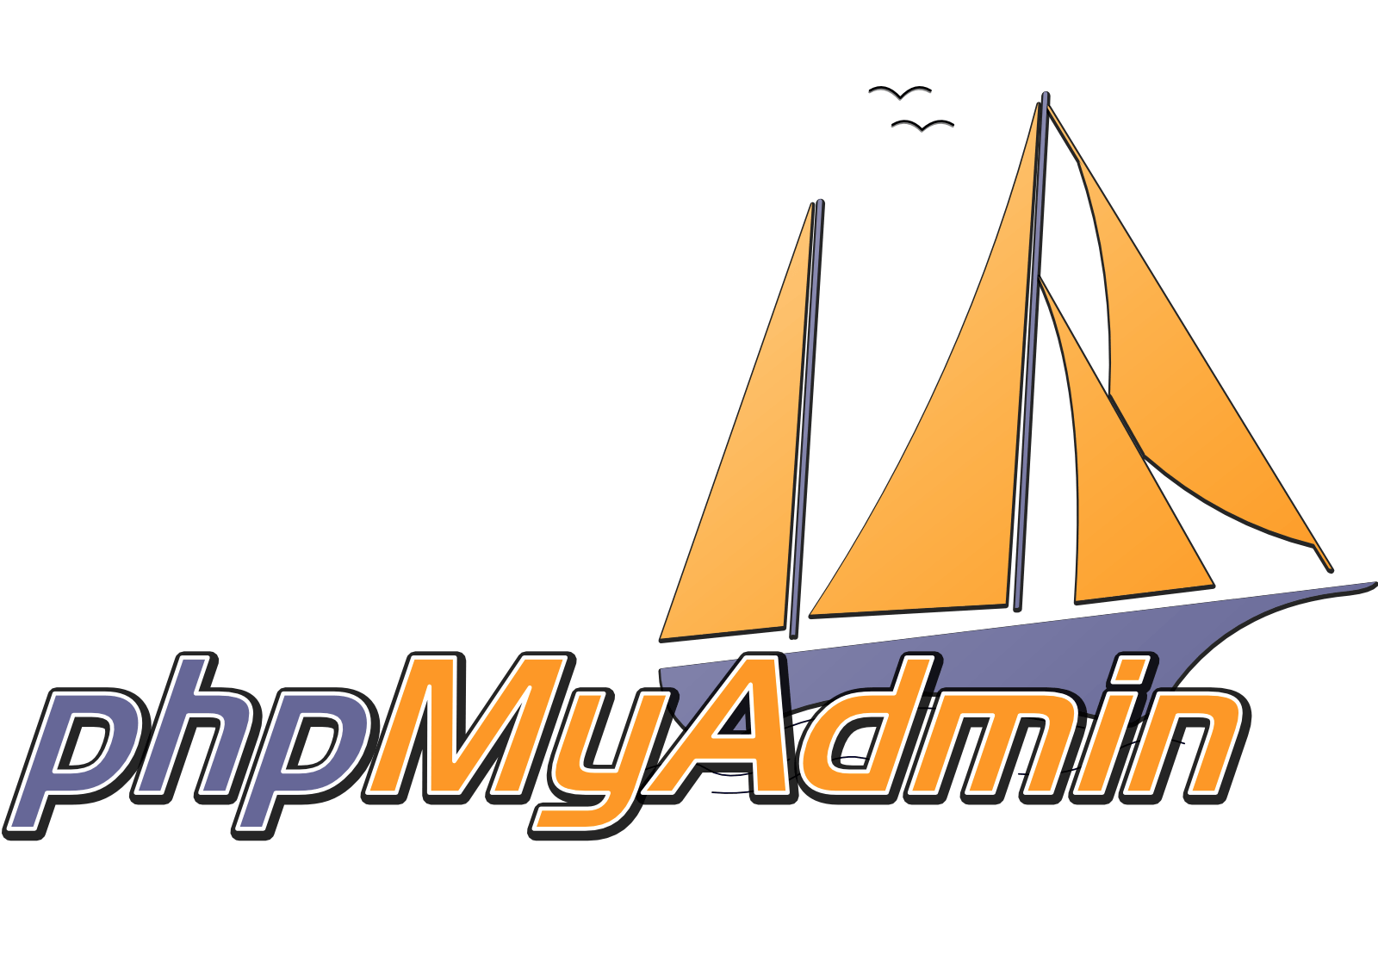
DevOps Challenges for Multiple Containers
How to scale?
How to avoid port conflicts?
How to manage them on multiple hosts?
What happens if a host has trouble?
How to keep them running?
How to update them?
Where are my containers?
Node
Node
Node
Node
Node
Node
Logger
@burrsutter bit.ly/8stepsawesome
Notes:
We saw the micoservice properties like elasticity, distribution etc., which leads to DevOps challenges

Slide 12
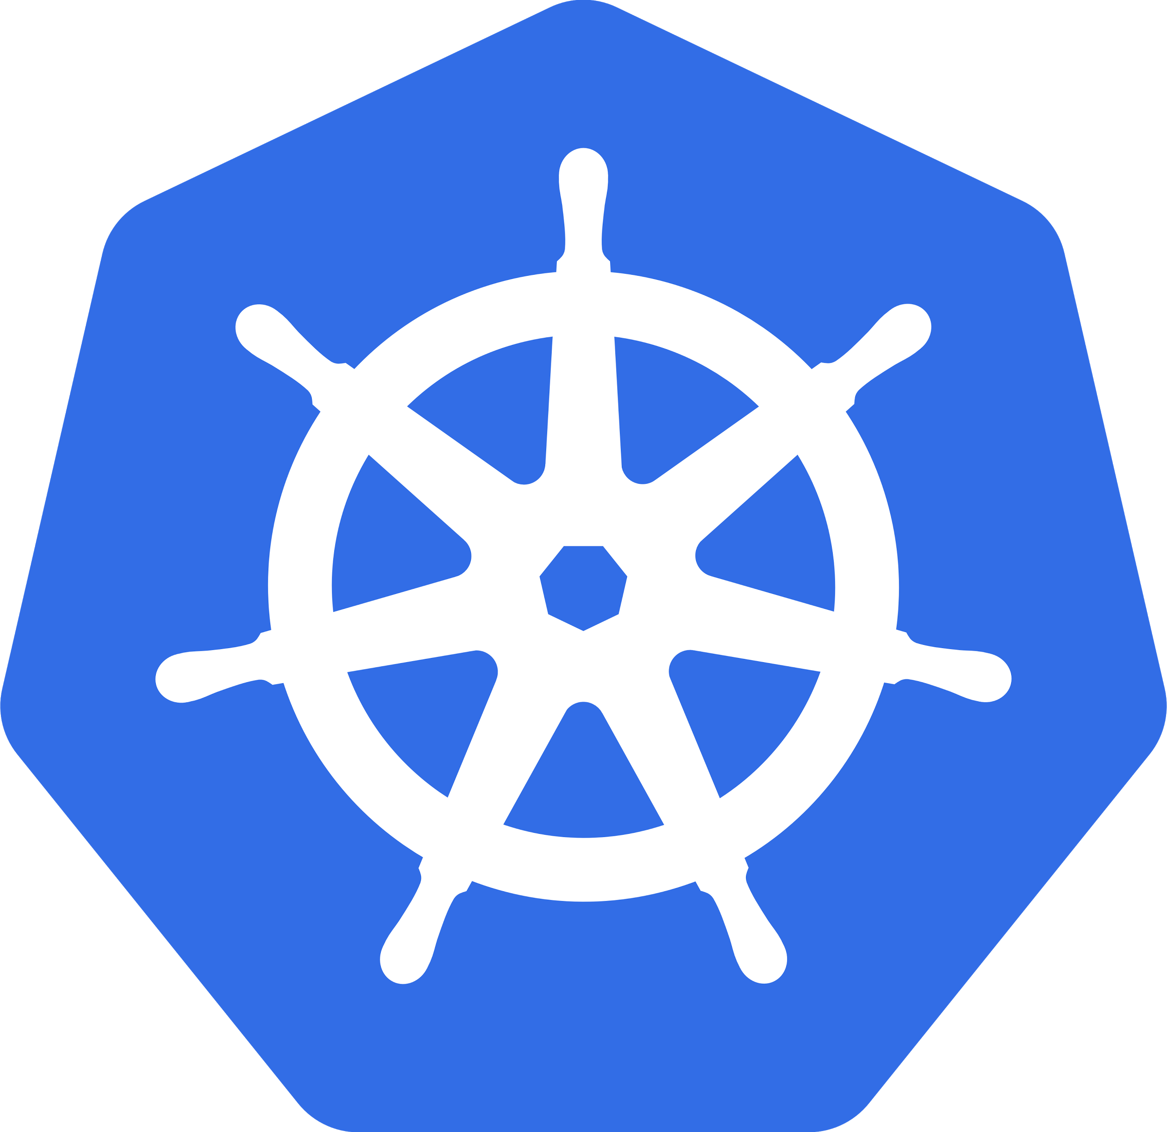
@burrsutter bit.ly/8stepsawesome
Notes:
Kubernetes supports a microservices architecture through the Service construct, typically the functionalities are abstracted in Pods and exposed as "Service" - which has name attached to it and can be called like API using the name. Kubernetes "Services" also does some rudimentary load balancing

Slide 13
Meet Kubernetes
Greek for “Helmsman,” also the root of the word “Governor” (from latin: gubernator)
Container orchestrator
Supports multiple cloud and bare-metal environments
Inspired by Google’s experience with containers
Open source, written in Go
Manage applications, not machines
@burrsutter bit.ly/8stepsawesome

Slide 14
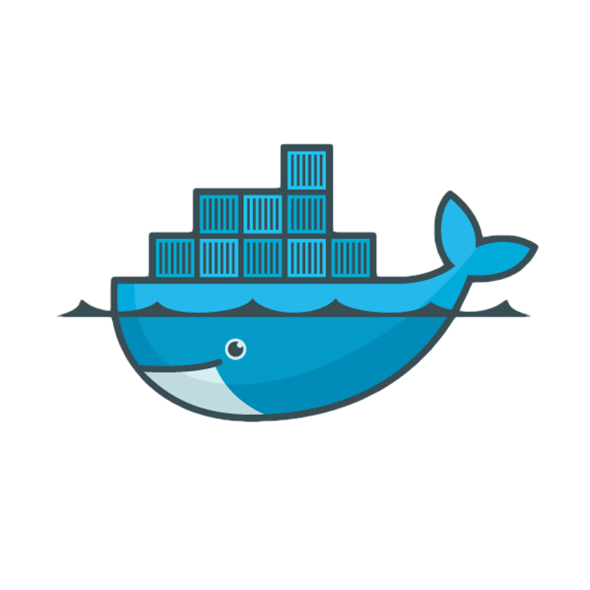
Pods
A group of whales is commonly referred to as a pod and a pod usually consists a group of whales that have bonded together either because of biological reasons or through friendships developed between two or more whales.
In many cases a typical whale pod consists of anywhere from 2 to 30 whales or more.*
*http://www.whalefacts.org/what-is-a-group-of-whales-called/
@burrsutter bit.ly/8stepsawesome

Slide 15


Kubernetes Cluster
Replication Controller/
Deployment
Pod
Service
Label
1+ containers
Shared IP
Shared storage volume
Shared resources
Shared lifecycle
Ensures that a specified number of pod replicas are running at any one time
Grouping of pods (acting as one) has stable virtual IP and DNS name
Key/Value pairs associated with Kubernetes objects (env=production)
@burrsutter bit.ly/8stepsawesome

Slide 16



Kubernetes Cluster
Node
Node
Node
Master
Dev
api
etcd
scheduler
Node
Node
Node
controllers
Logger
Ops
@burrsutter bit.ly/8stepsawesome
developers.redhat.com
Notes:
Kubernetes origins come from Borg & Omega. Google’s container/cluster management solutions. Google launches 2 billion containers per week.
Red Hat is the largest contributor to Kubernetes outside of Google. We support Kubernetes for enterprise customers via Openshift Enterprise.

Slide 17
Key Kubernetes Capabilities
Self-healing
Horizontal Manual & Auto Scaling
Automatic Restarting
Scheduled across hosts
Built-in load-balancer
Rolling upgrades
@burrsutter bit.ly/8stepsawesome
developers.redhat.com

Slide 18
Kubernetes Commands
https://kubernetes.io/docs/user-guide/kubectl/
kubectl get namespaces
kubectl get pods
kubectl run myvertx --image=burr/myvertx:v1 --port=8080
kubectl logs myvertx-kk605
kubectl expose deployment --port=8080 myvertx --type=LoadBalancer
kubectl scale deployment myvertx --replicas=3
kubectl set image deployment/myvertx myvertx=burr/myvertx:v2
@burrsutter bit.ly/8stepsawesome
developers.redhat.com

Slide 19
Kubernetes Tutorial
kubernetesbyexample.com
@burrsutter bit.ly/8stepsawesome

Slide 20

Microservices == Distributed Computing
Pod
Pod
Container
Container
JVM
JVM
Service A
Service C
Pod
Container
JVM
Service B
@burrsutter bit.ly/8stepsawesome

Slide 21




java -jar myapp.jar
DropWizard
www.dropwizard.io
JAX-RS API
First to market
DropWizard Metrics
Embeddable servers:
Jetty
Spring Boot
projects.spring.io/spring-boot
Spring API (@RestController)
‘Starter’ POMs: start.spring.io
Embeddable servers:
Tomcat, Jetty, Undertow
WildFly Swarm
wildfly-swarm.io
MicroProfile.io
‘Starter’ POMs: wildfly-swarm.io/generator
Embeddable servers:
WildFly (Undertow)
Vert.x
vertx.io
Reactive
Async/non-blocking
vertx run myhttp.java
HTTP, HTTP/2, TCP, UDP, Websockets, etc. (out of the box)
@burrsutter

Slide 22

Defines open source Java microservices specifications
Industry Collaboration - Red Hat, IBM, Payara, Tomitribe, London Java Community, SouJava, Oracle, Hazelcast, Fujitsu, SmartBear...
WildFly Swarm is Red Hat’s implementation
Minimum footprint for Enterprise Java cloud-native services (v1.3) :
JSON-P 1.0
Health Check
JWT Propagation
Config
OpenAPI
REST Client
CDI 1.2
JAX-RS 2.0
Fault Tolerance
Metrics
Open Tracing
@burrsutter bit.ly/8stepsawesome

Slide 23

Short History of Microservices
AWS EC2
2006
Java EE6
2009
DropWizard
May 2011
Hystrix
March 2012
Eureka
July 2012
Spring Boot
Sept 2013
Kubernetes
June 2014
Continuous
Integration
via XP
1999
DevOps
2009
Agile
Manifesto
Feb
2001
NETFLIX
to AWS
2010
Ribbon
March 2012
Microservices
Assess
Thoughtworks
Radar
March 2012
Docker
March
2013
Microservices
Defined
Thoughtworks
Fowler, Lewis
March 2014
@burrsutter bit.ly/8stepsawesome
Notes:
http://redmonk.com/sogrady/2014/03/27/micro-services/
https://www.slideshare.net/adriancockcroft/speeding-up-31799721
https://en.wikipedia.org/wiki/Java_EE_version_history#Java_EE_6_.28December_10.2C_2009.29
https://assets.thoughtworks.com/assets/technology-radar-march-2012.pdf
Netflix and Kubernetes https://www.youtube.com/watch?v=57UK46qfBLY&feature=youtu.be&t=37m21s
https://thenewstack.io/github-goes-kubernetes-tells/
Docker born March 2013
https://www.youtube.com/watch?v=9xciauwbsuo

Slide 24

February 2013
@burrsutter bit.ly/8stepsawesome
Notes:
The first Internet-based series to be nominated and win Emmy and Golden Globe awards
http://www.nasdaq.com/article/the-importance-of-house-of-cards-to-netflix-cm588662
https://www.forbes.com/sites/petercohan/2013/04/23/how-netflix-reinvented-itself/#35320d2f2886
http://www.nydailynews.com/entertainment/tv-movies/netflix-house-cards-game-changer-article-1.1264563

Slide 25







Java Microservices Platform circa 2015
Config Server
NETFLIX Ribbon
@burrsutter bit.ly/8stepsawesome

Slide 26


Better Microservices Platform circa 2016
Config Server
NETFLIX Ribbon
@burrsutter bit.ly/8stepsawesome

Slide 27


Better Microservices Platform circa 2017
Config Server
Jaeger
NETFLIX Ribbon
@burrsutter bit.ly/8stepsawesome

Slide 28

Better Microservices Platform circa 2018
Config Server
Jaeger
Istio
NETFLIX Ribbon
@burrsutter bit.ly/8stepsawesome

Slide 29




Polyglot Microservices Platform circa 2018
Config Server
Jaeger
Istio
NETFLIX Ribbon
@burrsutter bit.ly/8stepsawesome

Slide 30
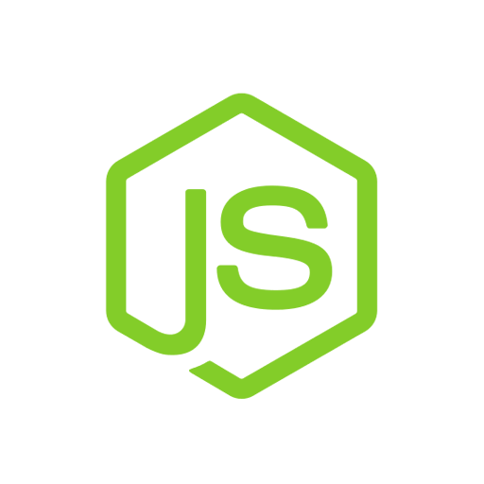

API
Tracing
Discovery
Monitoring
Invocation
MyService
Logging
Elasticity
Authentication
Resilience
Pipeline
Polyglot Microservices Platform
@burrsutter bit.ly/8stepsawesome

Slide 31
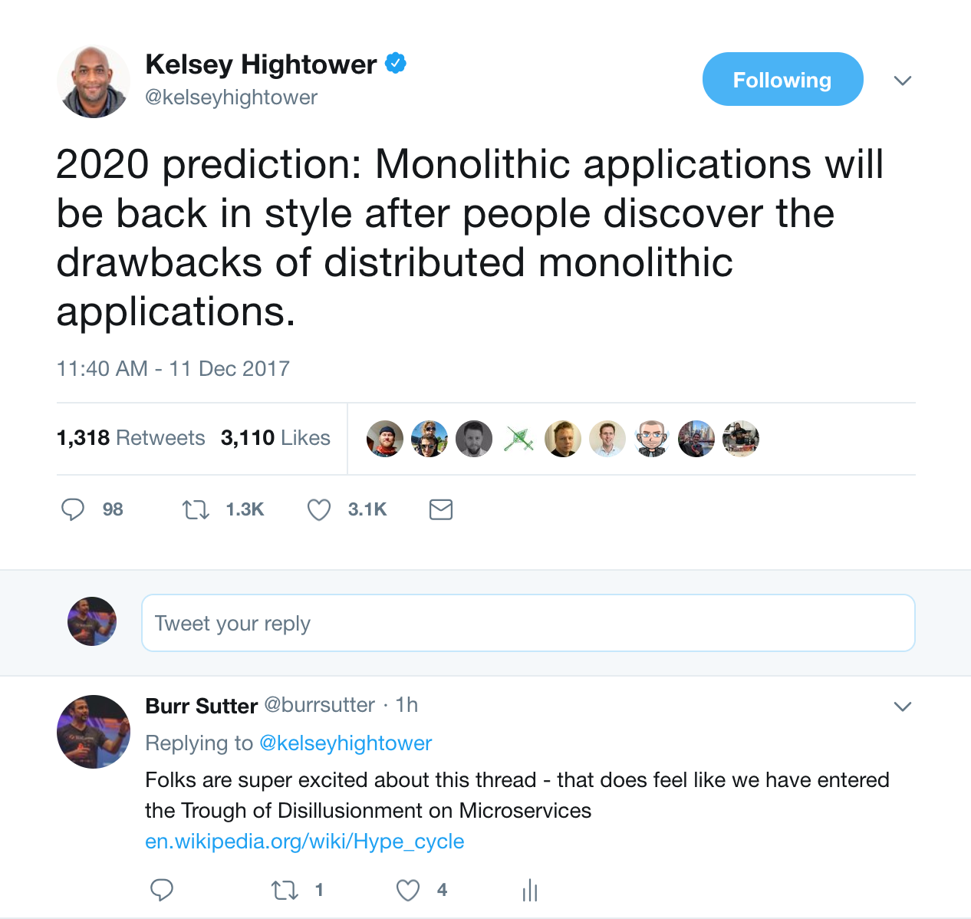
@burrsutter
Notes:
https://twitter.com/kelseyhightower/status/940259898331238402

Slide 32
JBCNConf 2018
Tuesday: June 12 2018
How to Not Suck at Microservices - Rafael Benevides 11:35
JVM in container die hard - Antonin Stefanutti 11:35 (bit.ly/javadockerfail)
From Legacy to Cloud - Roland Huss 12:40
The next evolution of microservices patterns with Istio Mesh - Christian Posta 14:55

Slide 33
8 Steps
@burrsutter bit.ly/8stepsawesome

Slide 34
Step 1: Installation
@burrsutter bit.ly/8stepsawesome

Slide 35
Step 1 - Installation
Lots of Options
minikube (kubectl) (docs)
minishift (oc) (docs)
Google Cloud Platform
Openshift.com
AWS
oc cluster up (requires a docker daemon)
Many more… https://kubernetes.io/docs/setup/pick-right-solution/#turnkey-cloud-solutions
@burrsutter bit.ly/8stepsawesome

Slide 36
Demo
@burrsutter bit.ly/8stepsawesome

Slide 37
Step 2: Building Images
@burrsutter bit.ly/8stepsawesome

Slide 38
Step 2: Building Images, Running Containers
docker build + kubectl run or kubectl create -f deploy.yml
Fabric8 maven plugin (fabric8.io)
Helm Charts - and Tiller
Kompose - converts docker-compose.yml to kubernetes yaml
Kedge - Concise Application Definitions for Kubernetes
Ansible - Playbooks for Kubernetes/Openshift deployment
s2i - source to image
podman - building Linux container images sans d-o-c-k-e-r
@burrsutter bit.ly/8stepsawesome
Notes:
https://fabric8.io/gitbook/mavenPlugin.html

Slide 39
Do NOT Java+Docker==FAIL
Slides: bit.ly/javadockerfail
Recording from JBCNConf 2017
@burrsutter bit.ly/8stepsawesome

Slide 40
myspringbootapp
package stuff.demo;
import org.springframework.web.bind.annotation.RequestMapping;
import org.springframework.web.bind.annotation.RestController;
@RestController
public class MyRESTEndpoint {
String hostname = System.getenv().getOrDefault("HOSTNAME", "unknown");
@RequestMapping("/")
public String index() {
return "Hello Spring " + new java.util.Date() + " " + hostname;
}
}
@burrsutter bit.ly/8stepsawesome

Slide 41
docker build + kubectl run
Dockerfile
FROM fabric8/java-jboss-openjdk8-jdk:1.3.1
ENV JAVA_APP_DIR=/deployments
EXPOSE 8080 8778 9779
COPY target/my.jar /deployments/
@burrsutter bit.ly/8stepsawesome

Slide 42
docker build + kubectl run
With Dockerfile
docker build -t burr/myimage:v1 .
docker run -it -p 8080:8080 burr/myimage:v1
curl $(minishift ip):8080
ctrl-c
kubectl run myapp --image burr/myimage:v1 --port 8080
kubectl expose deployment --port=8080 myapp --type=LoadBalancer
oc expose service myapp
curl myapp-stuff.$(minishift ip).nip.io
kubectl scale --replicas=2 deploy/myapp
docker build -t burr/myimage:v2 .
kubectl set image deployment/myapp myapp=burr/myimage:v2
@burrsutter bit.ly/8stepsawesome

Slide 43
Fabric8 Maven Plugin
https://maven.fabric8.io/#fabric8:setup (no Dockerfile)
oc new-project stuff
mvn clean compile package
mvn io.fabric8:fabric8-maven-plugin:3.5.39:setup
mvn fabric8:deploy
@burrsutter bit.ly/8stepsawesome

Slide 44
Demo
https://github.com/burrsutter/kube4docker
@burrsutter bit.ly/8stepsawesome

Slide 45
Step 3: oc or kubectl exec
@burrsutter bit.ly/8stepsawesome

Slide 46
Step 3: oc or kubectl exec
ssh into your containers and explore
kubectl get pods --namespace=microworld
kubectl exec -it --namespace=microworld $POD cat /sys/fs/cgroup/memory/memory.limit_in_bytes
or
kubectl exec -it --namespace=microworld microspringboot1-2-nz8f8 /bin/bash
ps -ef | grep java
Note: the following apply if using the fabric8 generated image, otherwise consult your Dockerfile
java -version
javac -version
# now find that fat jar
find / -name *.jar
cd /deployments (based on use of the fabric8 maven plugin)
ls
exit
@burrsutter bit.ly/8stepsawesome

Slide 47
Demo
https://github.com/burrsutter/javadockerfail

Slide 48
Step 4: logs
@burrsutter bit.ly/8stepsawesome

Slide 49
Step 4: logs
System.out.println("Where am I?"); Or console.log("Node logs");
Spring Boot logs by default just go to the console.
kubectl get pods
kubectl logs microspringboot1-2-nz8f8
OR ./kubetail.sh
https://raw.githubusercontent.com/johanhaleby/kubetail/master/kubetail
OR stern (brew install stern)
https://github.com/wercker/stern
@burrsutter bit.ly/8stepsawesome
Notes:
https://github.com/c-bata/kube-prompt

Slide 50
Demo
@burrsutter bit.ly/8stepsawesome

Slide 51
Step 5: service discovery & load-balancing
@burrsutter bit.ly/8stepsawesome

Slide 52
Step 5: service discovery
Services are internal to the cluster and can be mapped to pods via a label selector
Just refer to a Service by its name, it is just DNS
String url = "http://producer:8080/";
ResponseEntity<String> response = restTemplate.getForEntity(url, String.class);
@burrsutter bit.ly/8stepsawesome

Slide 53
Samples
https://github.com/burrsutter/kube4docker/tree/master/discovery
https://github.com/redhat-developer-demos/microspringboot1
https://github.com/redhat-developer-demos/microspringboot2
https://github.com/redhat-developer-demos/microspringboot3
@burrsutter bit.ly/8stepsawesome

Slide 54
Step 6: Live and Ready
@burrsutter bit.ly/8stepsawesome

Slide 55
Step 5: Live and Ready
spec:
containers:
- name: myvertx
image: burr/myvertx:v1
livenessProbe:
httpGet:
port: http
path: /hello
initialDelaySeconds: 10
periodSeconds: 5
timeoutSeconds: 3
readinessProbe:
httpGet:
path: /hello
port: 8080
initialDelaySeconds: 10
periodSeconds: 3
@burrsutter

Slide 56
Demo
http://movies.app.burr.red/
https://github.com/redhat-developer-demos/popular-movie-store/blob/master/src/main/java/org/workspace7/moviestore/controller/HomeController.java#L158-L159
https://github.com/redhat-developer-demos/popular-movie-store/blob/master/src/main/fabric8/deployment.yml#L38-L42
@burrsutter bit.ly/8stepsawesome

Slide 57
Step 7: Rolling Updates, Blue/Green
Canary
@burrsutter bit.ly/8stepsawesome

Slide 58
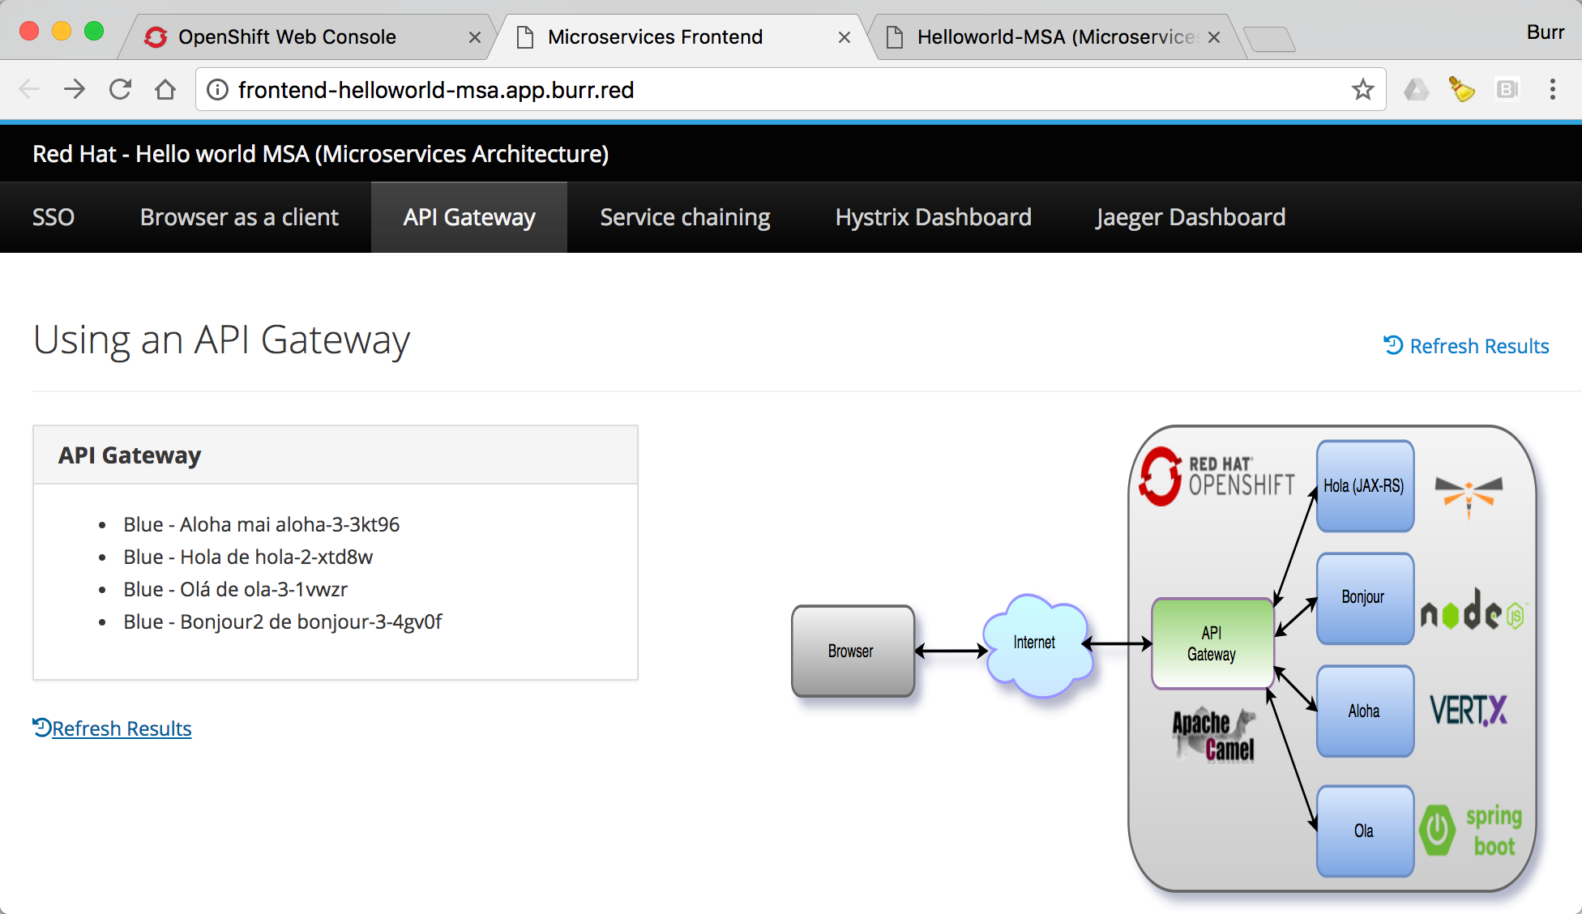
Step 7: Rolling, Blue/Green, Canary
bit.ly/msa-instructions
@burrsutter

Slide 59
Demo
@burrsutter bit.ly/8stepsawesome

Slide 60
Step 8: Debugging
@burrsutter bit.ly/8stepsawesome

Slide 61
Step 8: Debugging
https://maven.fabric8.io/#fabric8:debug
mvn fabric8:deploy
mvn fabric8:debug
https://code.visualstudio.com/blogs/2017/09/28/java-debug
https://github.com/VeerMuchandi/openshift-local/blob/master/DebuggingUsingIDE.md
@burrsutter bit.ly/8stepsawesome
Notes:
http://blog.christianposta.com/kubernetes/java-remote-debug-for-applications-running-in-kubernetes/
https://developers.redhat.com/blog/2017/12/19/debug-java-openshift-vscode-cdk/

Slide 62
Demo
@burrsutter bit.ly/8stepsawesome

Slide 63
Bonus: Istio
@burrsutter

Slide 64
Istio - Sail
(Kubernetes - Helmsman or ship’s pilot)
bit.ly/istio-intro
@burrsutter bit.ly/8stepsawesome

Slide 65
Next Gen Microservices - Service Mesh
Code Independent
Intelligent Routing and Load-Balancing
A/B Tests
Canary Releases
Dark Launches
Distributed Tracing
Circuit Breakers
Fine grained Access Control
Telemetry, metrics and Logs
Fleet wide policy enforcement
@burrsutter bit.ly/8stepsawesome

Slide 66
Istio Control Plane
Pod
Pod
Pod
Container
Container
Container
JVM
JVM
JVM
HTTP1.1, HTTP2, gRPC, TCP w/TLS
Service A
HTTP1.1, HTTP2, gRPC, TCP w/TLS
Service B
HTTP1.1, HTTP2, gRPC, TCP w/TLS
Service C
Envoy Side-car
Envoy Side-car
Envoy Side-car
Istio Pilot
Istio Mixer
Istio Auth
istioctl, API, config
Quota, Telemetry Rate Limiting, ACL
CA, SPIFFE
@burrsutter bit.ly/8stepsawesome

Slide 67
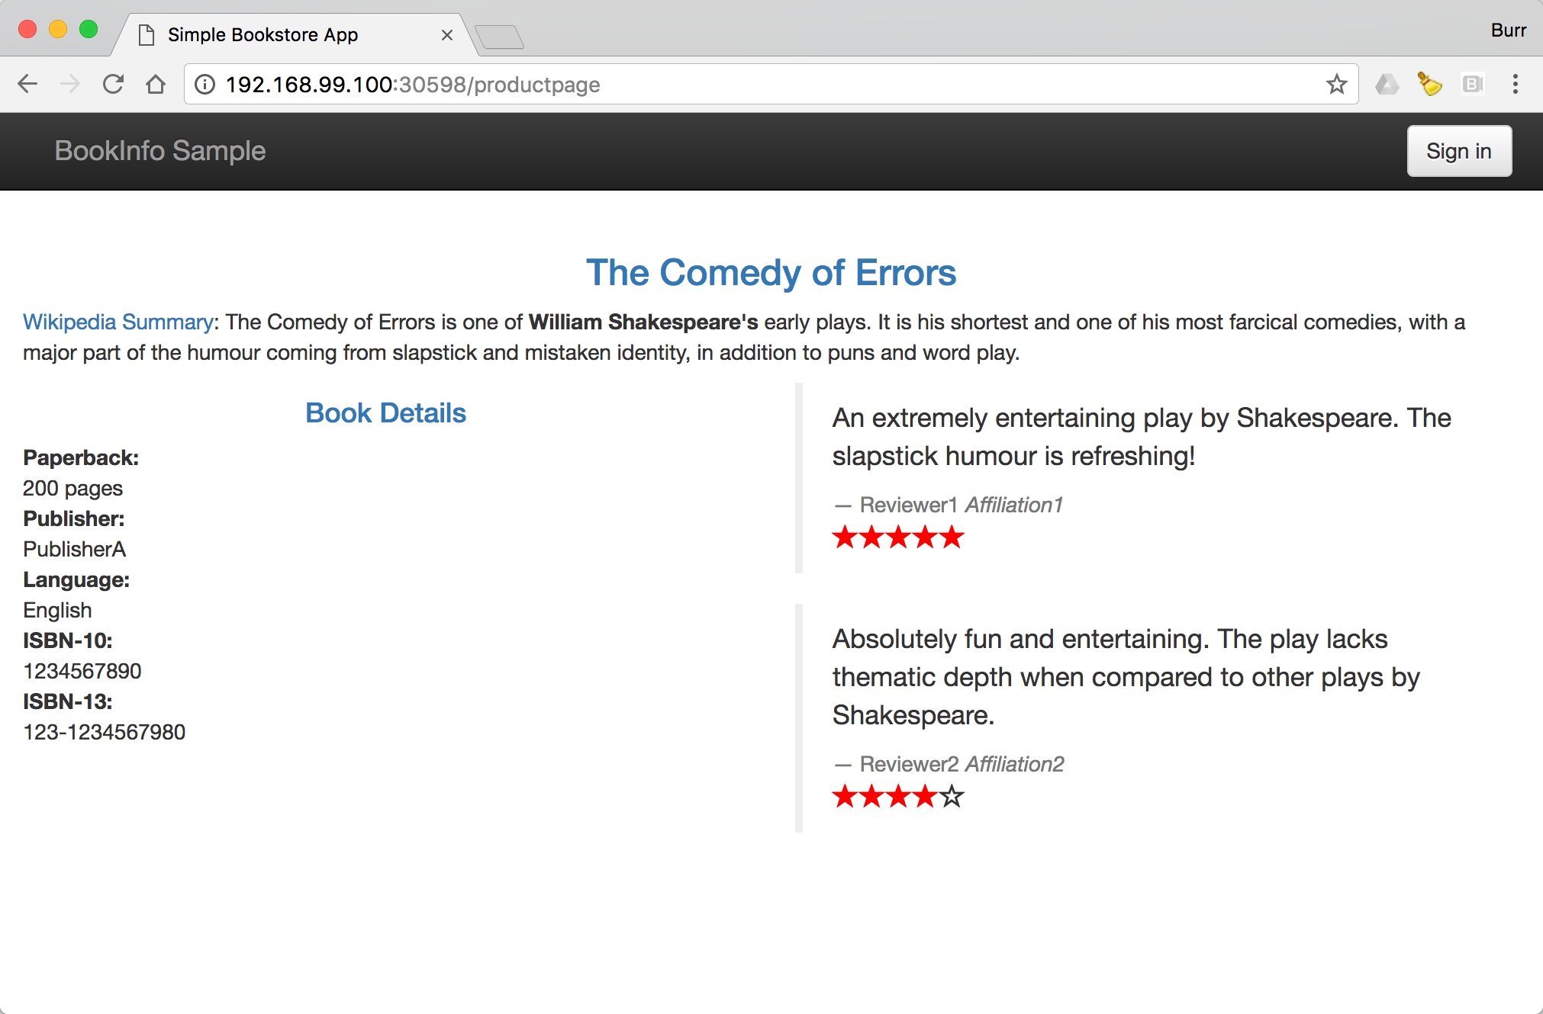
https://istio.io/docs/samples/bookinfo.html

Slide 68
Pilot
Mixer
Prometheus
Zipkin
Reviews
v1
Proxy
Ingress
Proxy
P
R
O
X
Y
P
R
O
X
Y
Ratings
Product
Page
Reviews
v2
Proxy
Reviews
v3
P
R
O
X
Y
Details
Proxy
https://www.youtube.com/watch?v=1SjJhwLrdbw&t=1s&index=11&list=PLuWlr4oKSRUYjjwDOaZOX-54X4_OIUUeS
@burrsutter bit.ly/8stepsawesome

Slide 69

bit.ly/istio-intro
bit.ly/istio-tutorial
learn.openshift.com/servicemesh
@burrsutter bit.ly/8stepsawesome

Slide 70
Bonus: Serverless/FaaS
bit.ly/faas-tutorial
learn.openshift.com/serverless
@burrsutter bit.ly/8stepsawesome

Slide 71
Bonus: Eclipse Che
@burrsutter bit.ly/8stepsawesome

Slide 72
Container Native IDE - Eclipse Che
Allows you to launch a browser-based IDE inside of a Linux container that matches your production environment
http://www.eclipse.org/che/docs/setup/openshift/index.html
Try it at openshift.io
@burrsutter bit.ly/8stepsawesome

Slide 73
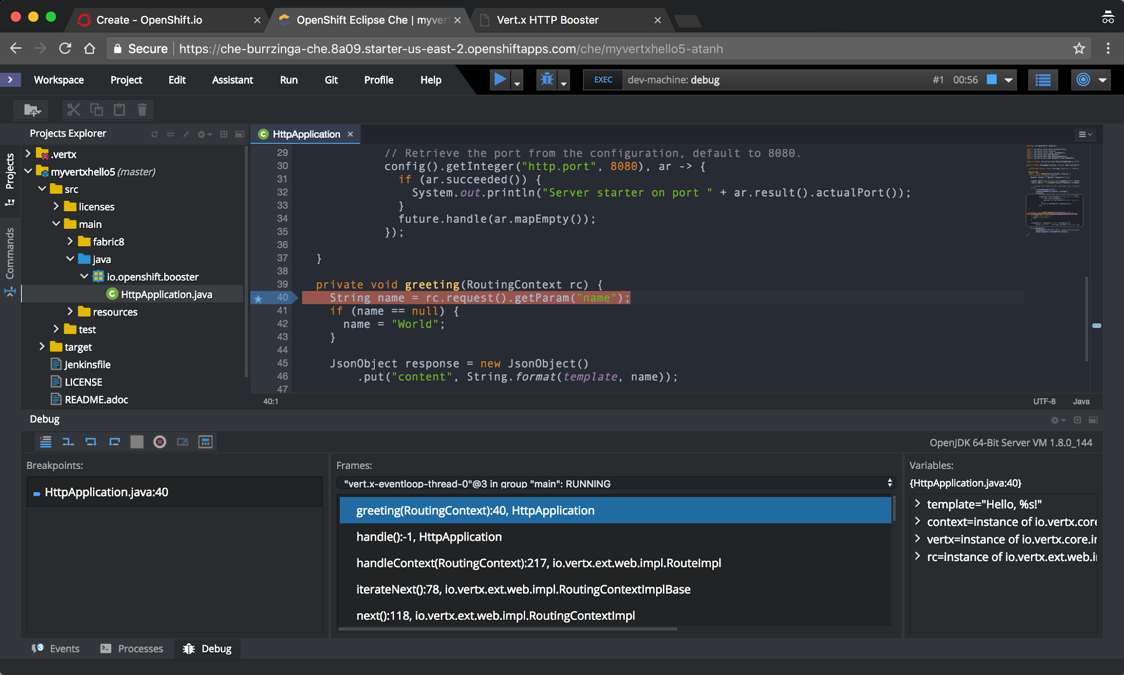

Slide 74
Resources
@burrsutter bit.ly/8stepsawesome

Slide 75
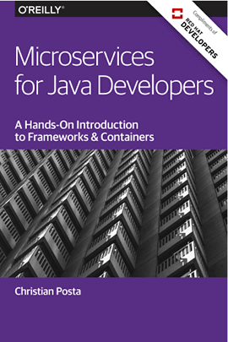
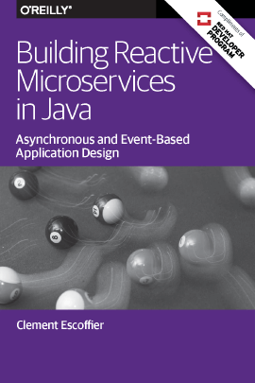
bit.ly/javamicroservicesbook
bit.ly/reactivemicroservicesbook
Free eBooks from developers.redhat.com
Microservices Introductory Materials
Demo: bit.ly/msa-instructions
Slides: bit.ly/microservicesdeepdive
Video Training: bit.ly/microservicesvideo
Kubernetes for Java Developers
Advanced Materials
bit.ly/istio-tutorial
bit.ly/faas-tutorial
learn.openshift.com/servicemesh
learn.openshift.com/serverless
@burrsutter

Slide 76
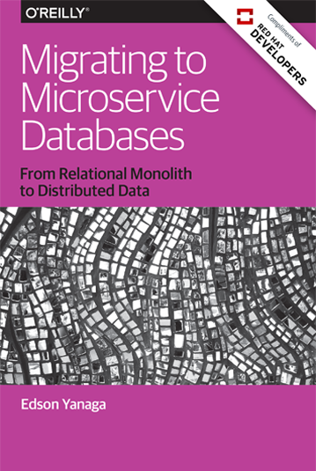
bit.ly/mono2microdb
@burrsutter

Slide 77
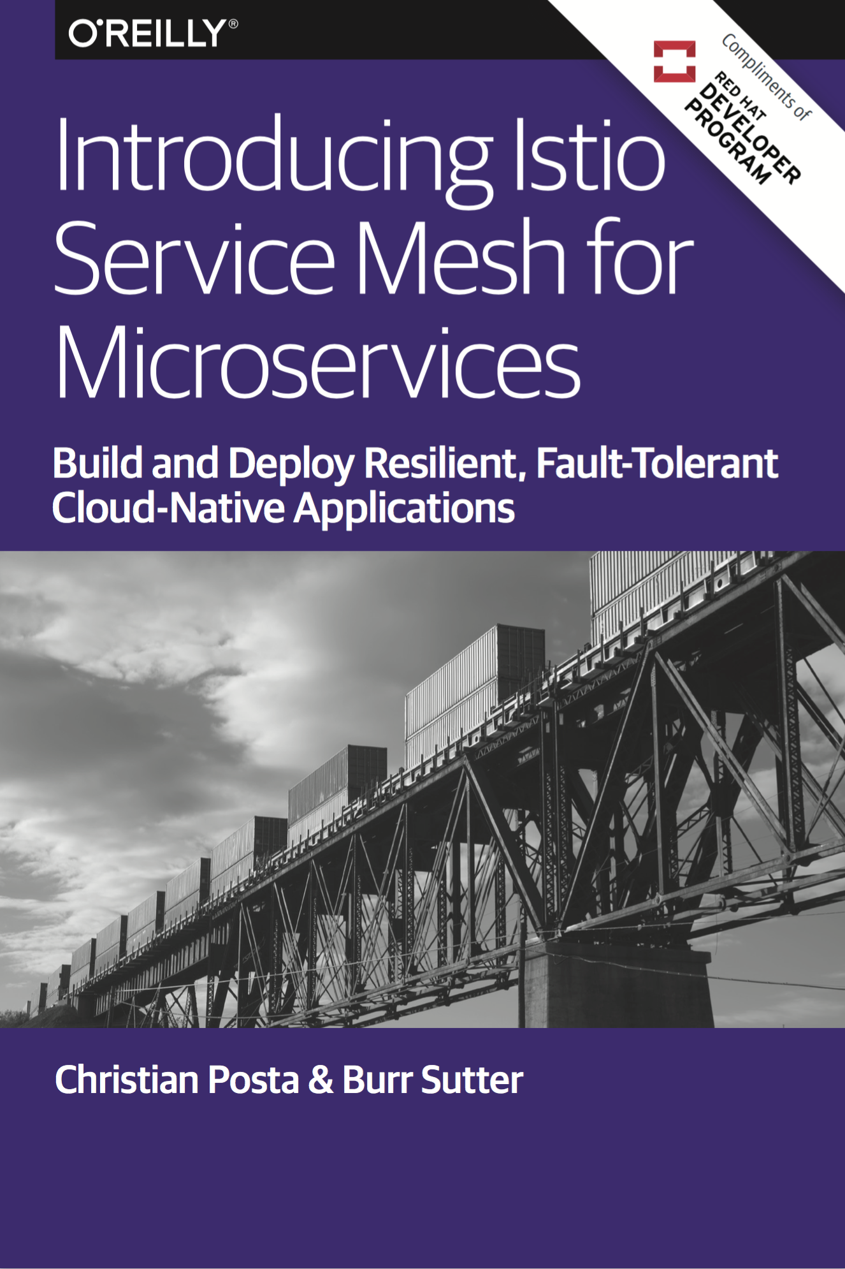
bit.ly/istio-book
@burrsutter

Slide 78
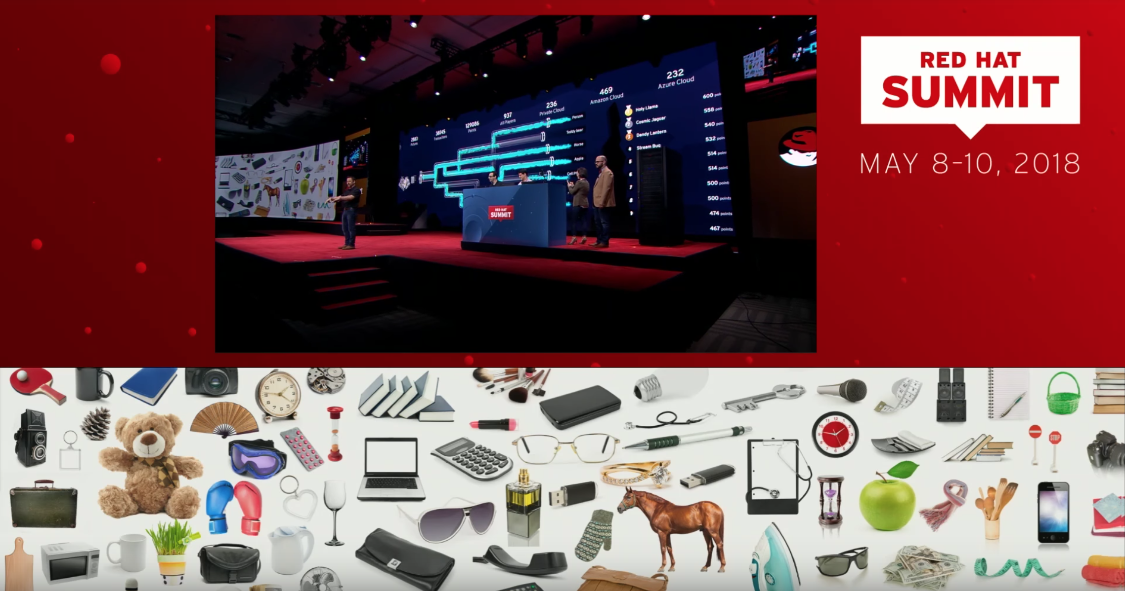
Keynote Demo 2018
https://youtu.be/hu2BmE1Wk_Q?t=477
@burrsutter bit.ly/8stepsawesome

Slide 79
8 Steps to Becoming Awesome with Kubernetes
@burrsutter
burr@redhat.com
https://developers.redhat.com/devnationlive/
http://bit.ly/8stepsawesome
Link

